Slide 1

INSTITUTE: UIE (AIT-CSE)
Computer Networks CST- 335
TCP HEADER,
SEGMENT STRUCTURE,
Transmission policy, timer management
Transactional TCP.
By : Dr.Monica Luthra(E9836)
DISCOVER . LEARN . EMPOWER

Slide 2

Course Objectives
CO Number | Title | Level
CO1 | To bring together several keys to Computer Network Design and Architecture. | Remember
CO2 | To recognize the key concepts of Internetworking. | Understand
CO3 | To prepare a sample Network via Simulation. | Understand

Slide 3
Course Objectives
CO Number | Title
CO1 | Describe the important networking concepts
CO2 | Understand concept of network reference models and protocols
CO3 | Apply the concepts of routing algorithms on various networks
CO4 | Identify mechanism to handle traffic and control on congestion
CO5 | Identify and understand connection establishment techniques and features

Slide 4
Table of Contents
TCP HEADER
SEGMENT STRUCTURE
Transmission policy, timer management
Transactional TCP.

Slide 5
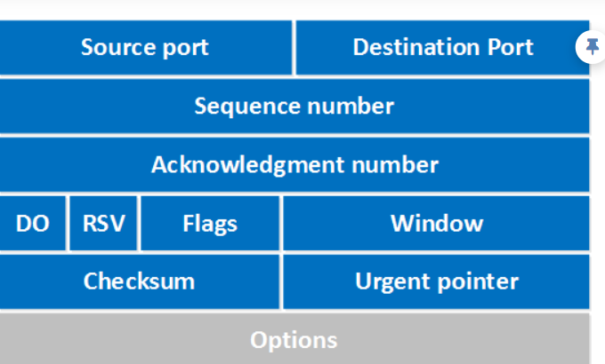
TCP HEADER,
TCP (Transmission Control Protocol) is a reliable transport protocol as it establishes a connection before sending any data and everything that it sends is acknowledged by the receiver. In this lesson we will take a closer look at the TCP header and its different fields. Here’s what it looks like:

Slide 6
Source port: this is a 16 bit field that specifies the port number of the sender.
Destination port: this is a 16 bit field that specifies the port number of the receiver.
Sequence number: the sequence number is a 32 bit field that indicates how much data is sent during the TCP session. When you establish a new TCP connection (3 way handshake) then the initial sequence number is a random 32 bit value. The receiver will use this sequence number and sends back an acknowledgment. Protocol analyzers like wireshark will often use a relative sequence number of 0 since it’s easier to read than some high random number.
Acknowledgment number: this 32 bit field is used by the receiver to request the next TCP segment. This value will be the sequence number incremented by 1.
DO: this is the 4 bit data offset field, also known as the header length. It indicates the length of the TCP header so that we know where the actual data begins.
RSV: these are 3 bits for the reserved field. They are unused and are always set to 0.

Slide 7
Flags: there are 9 bits for flags, we also call them control bits. We use them to establish connections, send data and terminate connections:
URG: urgent pointer. When this bit is set, the data should be treated as priority over other data.
ACK: used for the acknowledgment.
PSH: this is the push function. This tells an application that the data should be transmitted immediately and that we don’t want to wait to fill the entire TCP segment.
RST: this resets the connection, when you receive this you have to terminate the connection right away. This is only used when there are unrecoverable errors and it’s not a normal way to finish the TCP connection.
SYN: we use this for the initial three way handshake and it’s used to set the initial sequence number.
FIN: this finish bit is used to end the TCP connection. TCP is full duplex so both parties will have to use the FIN bit to end the connection. This is the normal method how we end an connection.
Window: the 16 bit window field specifies how many bytes the receiver is willing to receive. It is used so the receiver can tell the sender that it would like to receive more data than what it is currently receiving. It does so by specifying the number of bytes beyond the sequence number in the acknowledgment field.
Checksum: 16 bits are used for a checksum to check if the TCP header is OK or not.
Urgent pointer: these 16 bits are used when the URG bit has been set, the urgent pointer is used to indicate where the urgent data ends.
Options: this field is optional and can be anywhere between 0 and 320 bits.

Slide 8
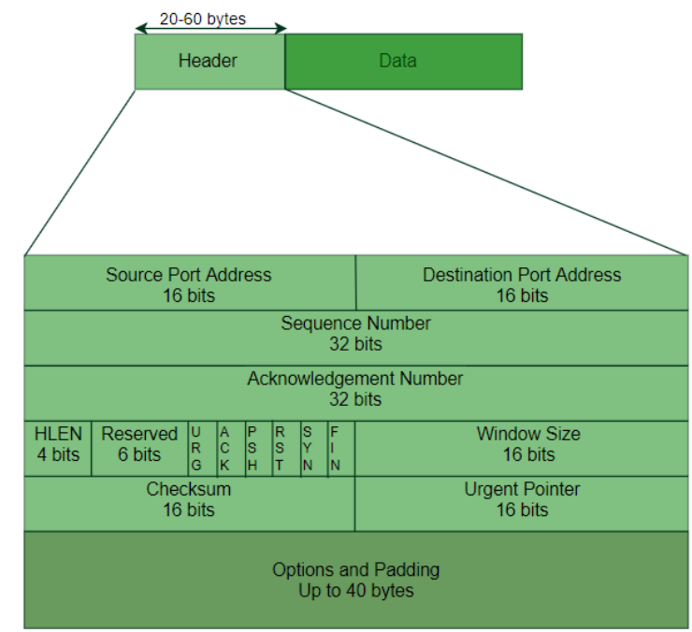
SEGMENT STRUCTURE
TCP Segment structure – A TCP segment consists of data bytes to be sent and a header that is added to the data by TCP as shown:

Slide 9
Timer Management
TCP uses different types of timer to control and management various tasks:
Keep-alive timer:
This timer is used to check the integrity and validity of a connection.
When keep-alive time expires, the host sends a probe to check if the connection still exists.
Retransmission timer:
This timer maintains stateful session of data sent.
If the acknowledgement of sent data does not receive within the Retransmission time, the data segment is sent again.

Slide 10
Persist timer:
TCP session can be paused by either host by sending Window Size 0.
To resume the session a host needs to send Window Size with some larger value.
If this segment never reaches the other end, both ends may wait for each other for infinite time.
When the Persist timer expires, the host re-sends its window size to let the other end know.
Persist Timer helps avoid deadlocks in communication.
Timed-Wait:
After releasing a connection, either of the hosts waits for a Timed-Wait time to terminate the connection completely.
This is in order to make sure that the other end has received the acknowledgement of its connection termination request.
Timed-out can be a maximum of 240 seconds (4 minutes).

Slide 11

References
https://en.wikipedia.org/wiki/Leaky_bucket
https://www.geeksforgeeks.org/leaky-bucket-algorithm/
https://en.wikipedia.org/wiki/Token_bucket
https://www.ques10.com/p/31441/what-is-traffic-shaping-explain-leaky-bucket-algor/

Slide 12
THANK YOU
For queries
Email: monica.e9836@cumail.in

